Slide 1
Clustering Social Networks
Isabelle Stanton, University of Virginia
Joint work with Nina Mishra, Robert Schreiber,
and Robert E. Tarjan

Slide 2
Outline
Motivation
Previous Work
Combinatorial properties
Finding Tightly Knit Clusters
Finding Loosely Knit Clusters
Future Work

Slide 3





Motivation
Many large social networks:
A fundamental problem is finding communities automatically
  Viral and Targeted Marketing
  Recommendation Engines
Notes:
Introduce what a community is: internally dense, externally sparse
explain viral marketing
Graphs are interesting to sociologist, anthropologists etc for studying how societies work

Slide 4
Previous Work
Modularity:
  M.E.J. Newman 2002
Spectral Methods:
  Kannan, Vempala, Vetta 2000, Spielman and Teng 1996, Shi and Malik 2000, Kempe and McSherry 2004, Karypis and Kumar 1998 and many others
Both require disjoint partitions of all elements
Notes:
Modularity: Compares the edge distribution with the expected distribution of a random graph with the same degrees
Spectral: Cuts the graph based on eigenvectors of the matrix
Partitions require that every vertex is in exactly 1 cluster

Slide 5
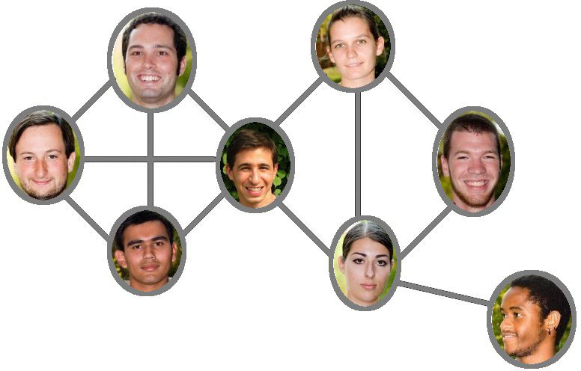
Communities in Social Networks
Disjoint partitionings are not good for social networks
Notes:
Use this to explain why partitionings are bad

Slide 6
Objective: Internal Density, β
Each vertex in C is adjacent to at least β fraction of (the rest of) C
Examples:
β=1/2
β=3/4
β=1

Slide 7
Objective: External Sparsity, α
Each vertex outside of C is adjacent to at most α of C
α < β
α=1/5, β=1
β=1

Slide 8
(α, β)-Clusters
C is an (α, β)- cluster if:
  Internally Dense: Every vertex in the cluster neighbors at least a β fraction of the cluster
  Externally Sparse: Every vertex outside the cluster neighbors at most an α fraction of the cluster
(1/4, 2/3)
(1/4, 1)
Notes:
Natural way of describing communities
Allows overlapping clusters
Does not require that every element be clustered

Slide 9
Previous Work – (α, β)-clusters
Solved Areas:
1
(1- ε,1) – Tsukiyama et al, Johnson et al.
α
α = 0 – connected components
β > ½ + α/2 – This work
0
0
1
β
Notes:
Explain the axis… i.e. as beta increases, it becomes a clique, as alpha decreases, it becomes disconnected components. Mention grayed out area doesn’t make sense as a cluster

Slide 10
Outline
Motivation
Previous Work
Combinatorial properties
  Can clusters overlap arbitrarily?
  How many clusters can there be?
Finding Tightly Knit Clusters
Finding Loosely Knit Clusters
Future Work

Slide 11
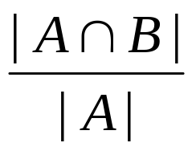
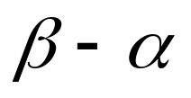
Combinatorial Properties - Overlaps
Let A and B be (α, β)-clusters with |A|=|B|
Theorem: A and B overlap by at most (1-(β-α))|A| vertices
1
0
0
1
Notes:
The following can be proved
This theorem shows that clusters do not arbitrarily overlap
Talk about containment here. Note that if they are of different sizes, then they can be contained in one another but restrictions can be put in place to stop this.

Slide 12
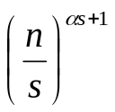
Combinatorial Properties - |Clusters|
Claim: There are at most (α,1)-clusters of size s in a graph
Proof is from Steiner Systems
  7 points, block size = 3, restriction = 2
  {1,2,4},{2,3,5},{3,4,6},{4,5,7},{1,5,6},{2,6,7},{1,3,7}
Bound is tight as α → 1 and α = 0. Seems loose elsewhere

Slide 13
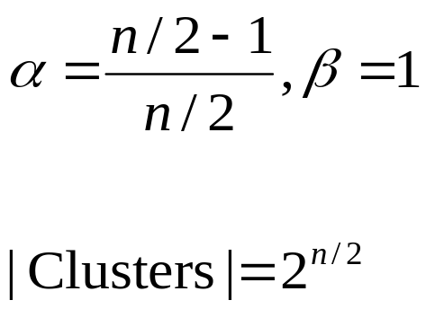
Too Many Clusters..
n vertices
MISSING edges drawn
x₁
y₁
x₂
y₂
...
x_{n/2}
y_{n/2}
Problem: Every vertex in every cluster has as many neighbors outside the cluster as in it

Slide 14
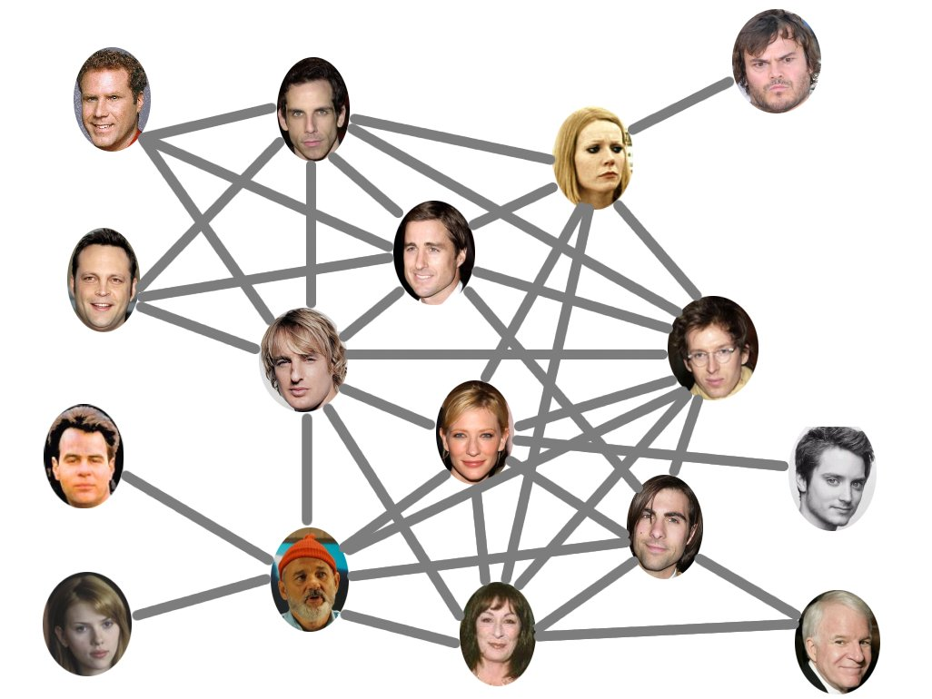
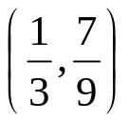
ρ-Champions
Ben Stiller
Gwenyth Paltrow
Will Ferrell
Vince Vaughn
Wes Anderson
Owen Wilson
Bill Murray
Steve Martin
Anjelica Houston
Notes:
If every member of the cluster has more neighbours outside the cluster than inside the cluster, then what ‘defines’ the cluster. We argue that rho-champions are a natural assumption for communities because they assume there is someone who is more ‘into’ the cluster than anything else and ‘defines’ the cluster. Formally, a rho champion is someone who is in an (alpha,beta) cluster, C, and has at most rho times the size of the cluster neighbours outside where rho < 1.

Slide 15
ρ-Champions
Def: A vertex is a ρ-champion of C if it has at most ρ|C| neighbors outside C
Claim: If ρ < 2β – 1 – α , every vertex can ρ-champion at most one cluster

Slide 16
Intuition behind the Algorithm
v
Let c be a ρ-champion
If v in C, then v and c share at least (2β -1)|C| neighbors
If v is outside C then v and c share at most (ρ + α)|C| neighbors
α|C|
β|C|
v
c
ρ|C|
β|C|
(2β-1)|C|
c
Notes:
If (2b-1)>(r+a) then we can distinguish between these two sets

Slide 17
Deterministic Algorithm
To find all clusters of size s:
for each c in V do
  C ← ∅
  For each v within two steps of c do
    If v and c share (2β – 1)s neighbors then add v to C
  If C is an (α, β)-cluster then output C
Notes:
We run this for the sizes of interest
Input: α, β, G, s = size of cluster
Output: All (α, β) clusters with ρ-champions

Slide 18
Algorithmic Guarantees
Claim: Our algorithm will find all clusters where β > ½ + (ρ + α)/2
Runs in O(d^{0.7}n^{1.9}+n^{2+o(1)}) time where d is the average degree
d is small for social networks so O(n²)

Slide 19
Outline
Motivation
Previous Work
Combinatorial properties
Finding Tightly Knit Clusters
Finding Loosely Knit Clusters
Future Work

Slide 20
Loosely Knit Clusters
β < ½
Technical Problem:
(0, 4/9)

Slide 21
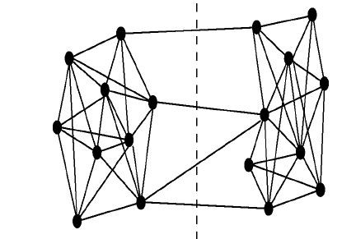
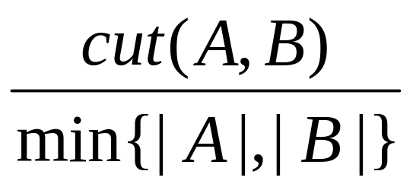
Expansion
A
B
Expansion of a cut:
cut(A,B)
Often used as a part of a criterion:
[Shi, Malik]
[Kannan, Vempala, Vetta]
[Flake, Tarjan, Tsioutsiouliklis] etc
|A|

Slide 22
Randomized Algorithm
for each c in V do
  Draw a sample of size t, k times
  For each sample, iteratively add vertices that have many neighbors in the sample
  When no more vertices can be added check if we have an (α, β)-cluster
Notes:
Input: α, β, G, k, t
Output: All (α, β) clusters w/ ρ-champions and ‘good’ expansion

Slide 23
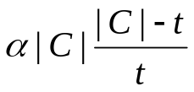
Guarantees
Claim: The randomized algorithm finds all clusters with a ρ-champions where the expansion is greater than with probability 1 - δ
Only relies on ρ-champions for good sampling probabilities

Slide 24
Conclusions
Defined (α, β)-clusters
Explored some combinatorial properties
Introduced ρ-champions
Developed algorithms for a subset of the problem

Slide 25
Future Work
Algorithms that reduce the necessary α-β gap
Relaxing ρ-champion restriction
Weighted and directed graphs
Decentralized algorithms
Streaming algorithms
Notes:
Streaming – social networks are not static, how does this affect the algorithm

Slide 26
Evaluation
Do ρ-champions exist in real graphs?
Tsukiyama’s algorithm finds all maximal cliques ((1-ε, 1)-clusters) in a graph
We compare our algorithm’s output with Tsukiyama’s ground truth
Notes:
We filtered Tsukiyama’s output so that it was a reasonable comparasion. Only cliques of size greater than 5 with alpha < .5 were considered.

Slide 27
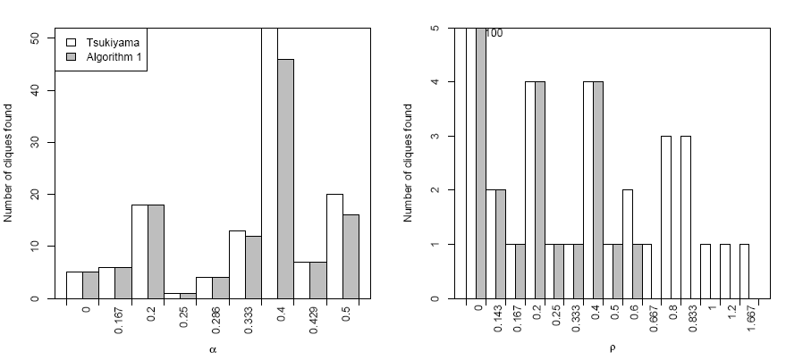
HEP Co-Author Dataset Results
Found 115 of 126 clusters ~ 90%
Notes:
Talk about how we didn’t find the ones without predicted rho champions

Slide 28
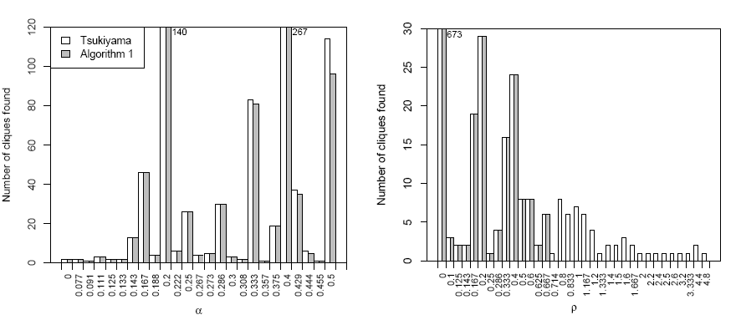
Theory Co-Author Dataset Results
Found 797 of 854 clusters ~ 93%
Notes:
Same story here

Slide 29
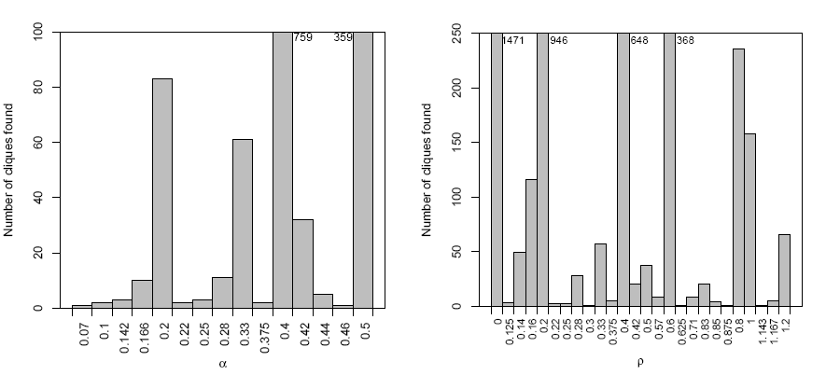
LiveJournal Dataset Results
Too big to run Tsukiyama. Found 4289 clusters, 876 have large ρ-champions
Notes:
Estimated 25 weeks. We found 4289 LJ cliques, 876 have ρ-champions beyond the predicted limit

Slide 30
Timing
Experiment | HEP | TA | LJ
Our Algorithm | 8 sec | 2 min 4 sec | 3 hours 37 min
Tsukiyama | 8 hours | 36 hours | N/A *
* Estimated Running Time 25 weeks
All experiments written in Python and run on a machine with 2 dual core 3 GHz Intel Xeons and 16 GB of RAM

Slide 31
Datasets
High Energy Physics Co-Authorship Graph
Theory Co-authorship graph
A subset of LiveJournal.com
Data Set | Size | Avg. Degree | Avg. τ(v)
HEP | 8,392 | 4.86 | 40.58
TA | 31,862 | 5.75 | 172.85
LJ | 581,220 | 11.68 | 206.15
τ(v) = the neighbors and neighbors’ neighbors of v

Slide 32
Previous Work - Modularity
Compares the edge distribution with the expected distribution of a random graph with the same degrees
Many competitive methods developed
Inherently defined as a partitioning
Introduced by Newman (2002)
Notes:
Intuitively, finds areas with more edges than expected internally and fewer than expected internally

Slide 33
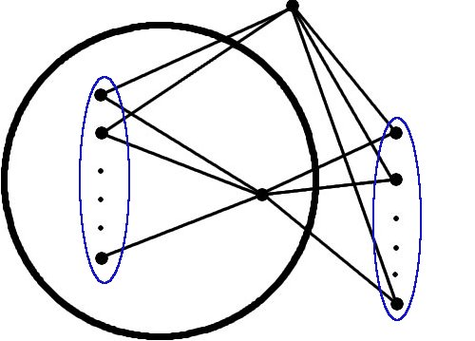
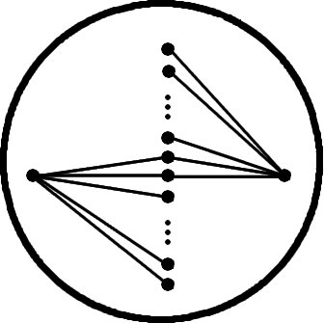
Intuition behind the Algorithm
Let c be a ρ-champion
If v in C, then v and c share at least (2β -1)|C| neighbors
If v is outside C then v and c share at most (ρ + α)|C| neighbors
v
α|C|
β|C|
v
c
β|C|
c
ρ|C|
β|C|
(2β-1)|C|
Notes:
If (2b-1)>(r+a) then we can distinguish between these two sets

